Slide 1

𝒜𝒯𝑀 𝐼𝓃𝓉𝑒𝓇𝒻𝒶𝒸𝑒

Slide 2
ABSTRACT
The ATM(Automatic Teller Machine) Interface is used to access client’s bank accounts in order to make cash withdrawals and check balance.
There are basically two types of bank accounts namely Checking and Savings
In order to make cash operations user needs to enter the correct Account number and PIN (Personal Identification Number) number, after which cash operations are made successful.
If the User failed to provide correct Account number and Pin number then automatically “Wrong Account/Pin message” displays.

Slide 3
SCOPE
Cash Operations can be performed without the need of Bank
It is a 24 hours service.
The tasks are easy to learn
Safe and Secure with Pin number

Slide 4
SYSTEM REQUIREMENTS
Operating System - Windows 10
Platform - Eclipse IDE
Software Language - Java

Slide 5
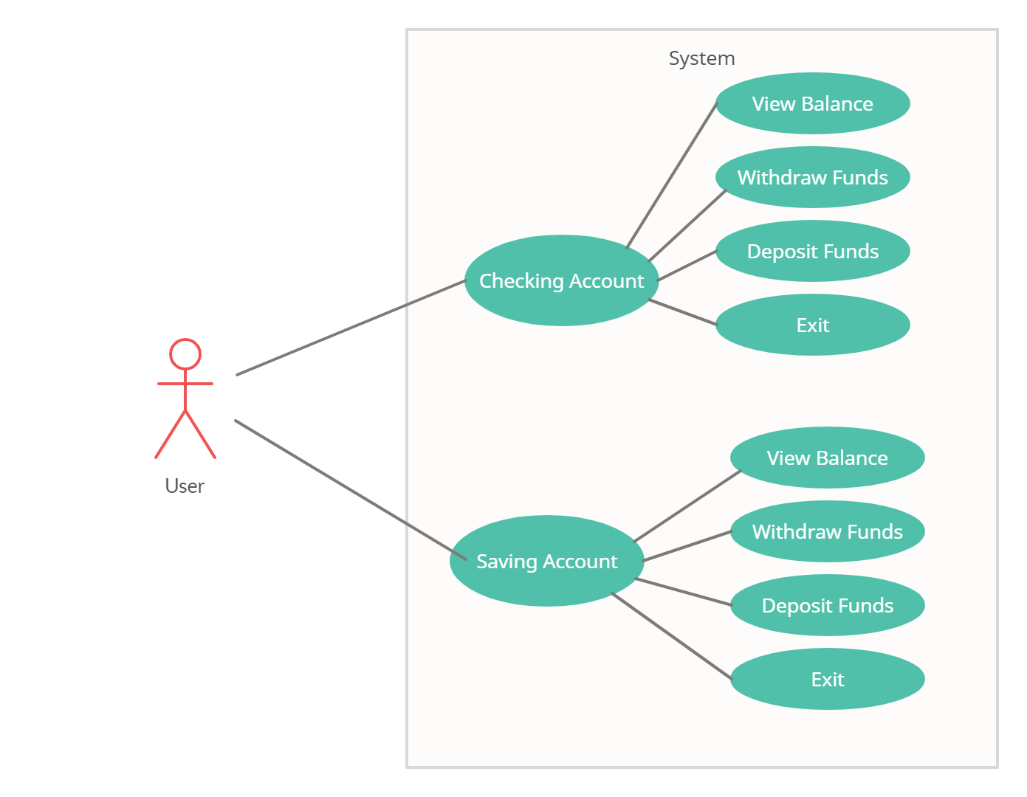
UML Diagram

Slide 6
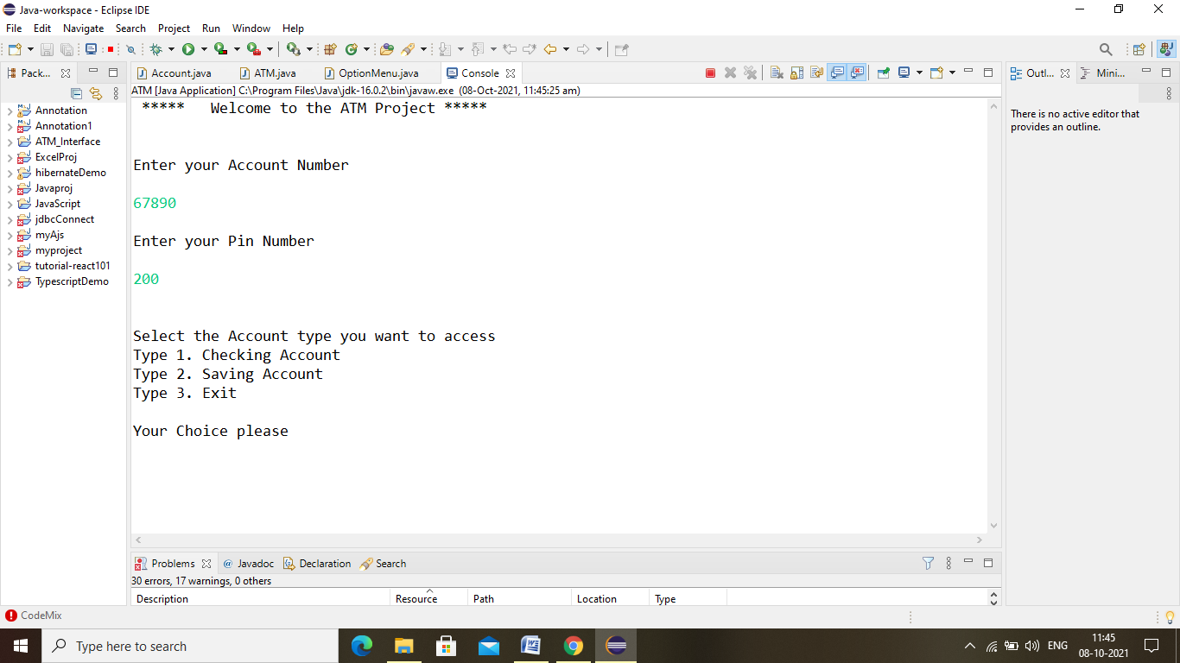

Slide 7
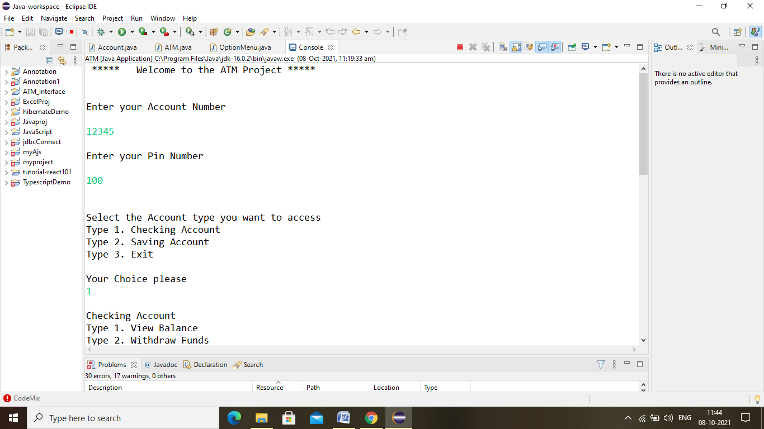

Slide 9
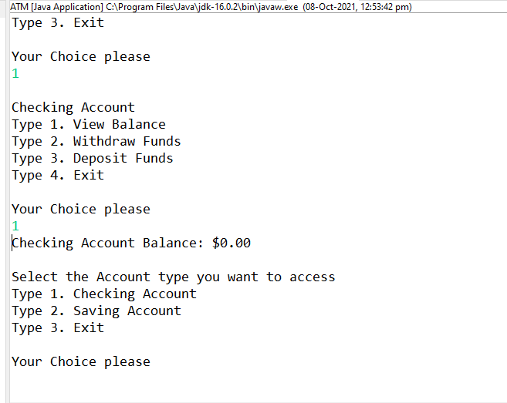

Slide 10
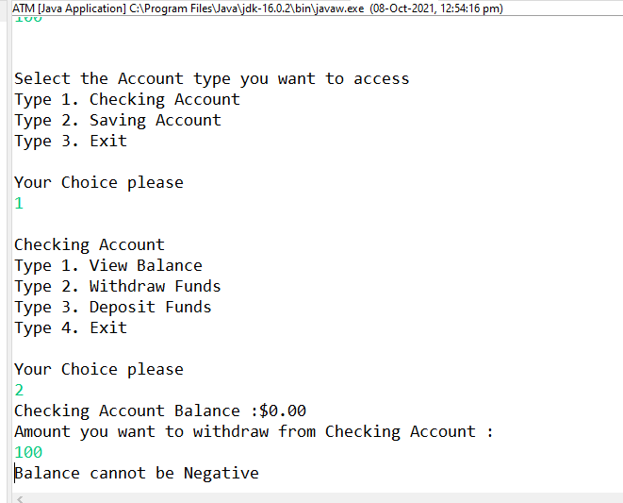

Slide 11
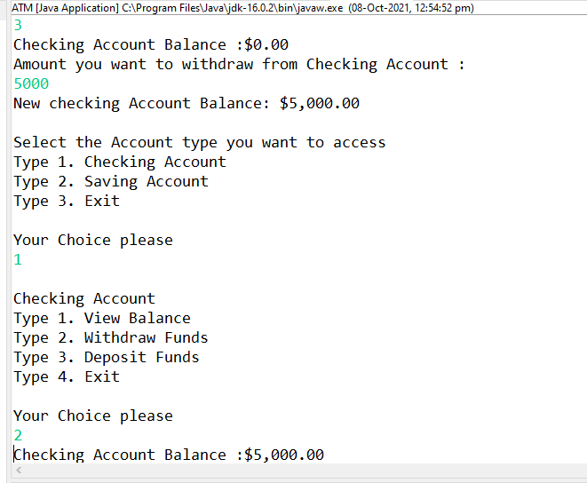

Slide 12
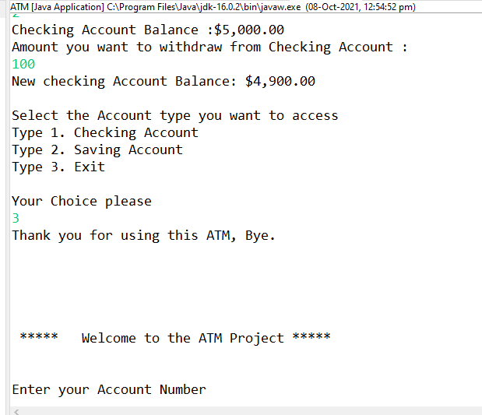

Slide 13
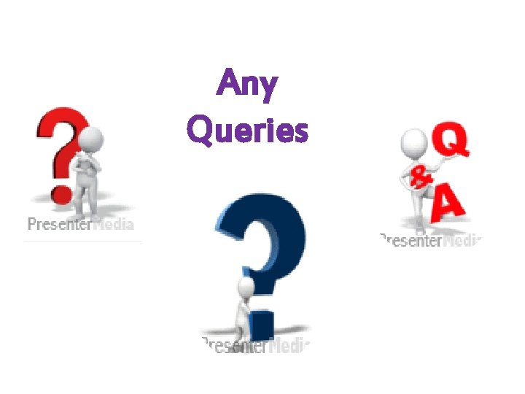

Slide 14


